Slide 1
轻松学OpenCV — 入门 原理 + 实战
作者：Tommy唐国梁

Slide 2
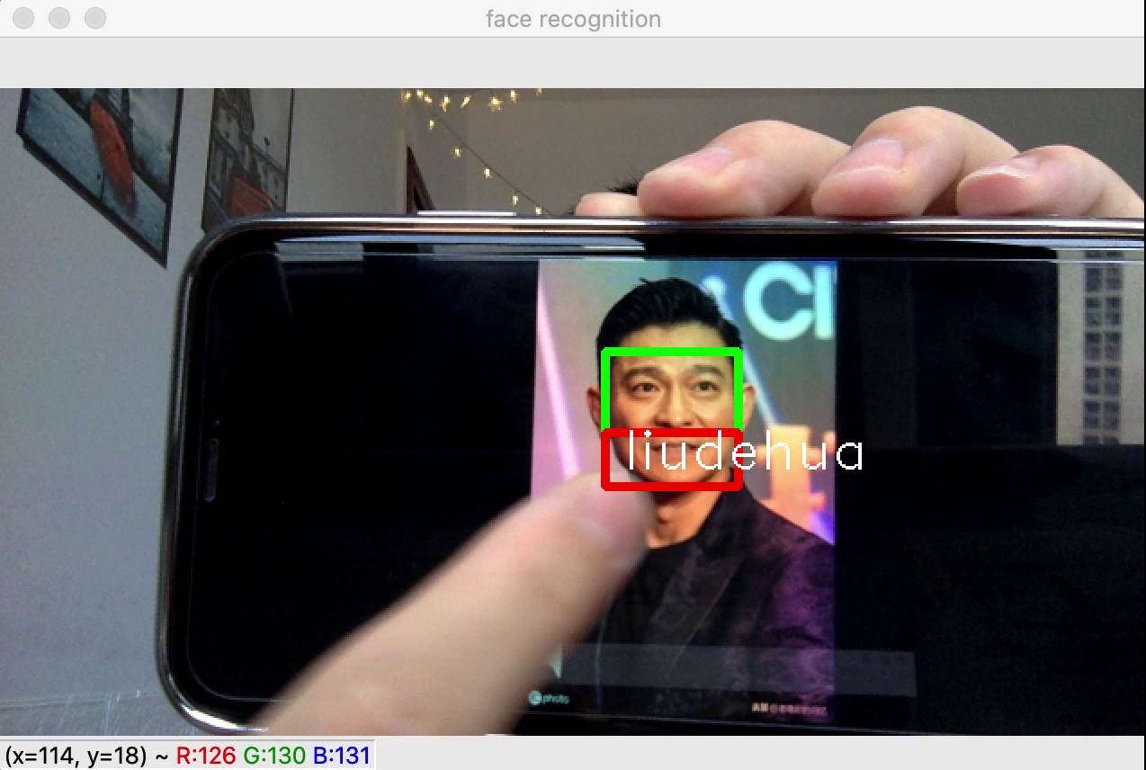
本节内容：face_recognition 人脸识别

Slide 3
用到的方法：
1. face_distance(face_encodings, face_to_compare)
2. face_locations(img, number_of_times_to_upsample=1, model="hog")
3. face_landmarks(face_image, face_locations=None, model="large")
4. face_encodings(face_image, known_face_locations=None, num_jitters=1, model="small")
5. compare_faces(known_face_encodings, face_encoding_to_check, tolerance=0.6)
face_recognition的API文档：
https://face-recognition.readthedocs.io/en/latest/_modules/face_recognition/api.html#face_locations

Slide 4

本节完
OpenCV 很简单，很简单，一起学啦 ^_^
个人公众号：我眼中的俄罗斯

